Slide 1
Chapter 5
Control Structures II (Repetition)

Slide 2
Objectives (1 of 2)
In this chapter, you will:
Learn about repetition (looping) control structures
Learn how to use a while loop in a program
Explore how to construct and use counter-controlled, sentinel-controlled, flag-controlled, and EOF-controlled repetition structures
Learn how to use a for loop in a program
Learn how to use a do…while loop in a program

Slide 3
Objectives (2 of 2)
Examine break and continue statements
Discover how to form and use nested control structures
Learn how to avoid bugs by avoiding patches
Learn how to debug loops

Slide 4
Why Is Repetition Needed?
Repetition allows efficient use of variables
It is possible to input, add, and average multiple numbers using a limited number of variables
Consider the code to determine the average number of calories burned each day doing regular exercise
Method 1: Declare a variable for each day and enter the number of calories burned, add the values and store in a variable for the week’s total, and divide the total by 7 to find the average
Method 2: Create a loop that reads a number into a variable and adds it to a variable that contains the sum of the numbers (only two variables needed)

Slide 5
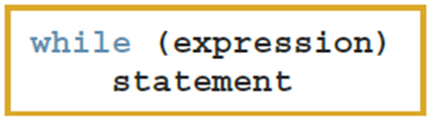
while Looping (Repetition) Structure (1 of 3)
A while loop is one of three repetition, or looping structures in C++
Syntax of the while statement
The statement can be simple or compound
The expression acts as a decision maker and is usually a logical expression
The statement is called the body of the loop
The parentheses are part of the syntax

Slide 6
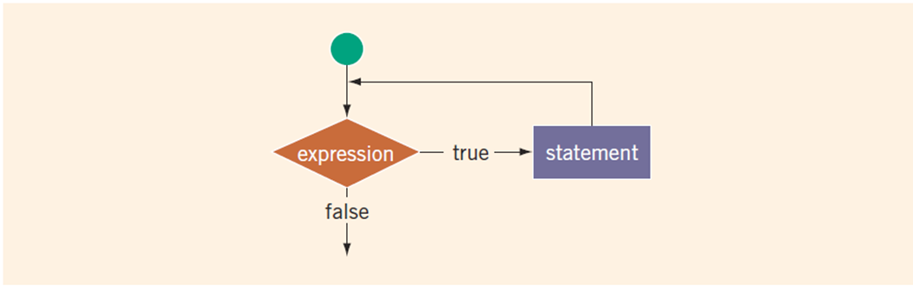
while Looping (Repetition) Structure (2 of 3)
FIGURE 5-1 while loop
The expression provides an entry condition to the loop
The statement (body of the loop) continues to execute until the expression is no longer true
An infinite loop continues to execute endlessly

Slide 7
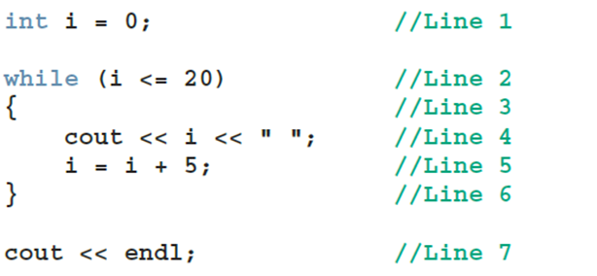
while Looping (Repetition) Structure (3 of 3)
EXAMPLE 5-1
Consider the following C++ program segment:
The preceding while loop produces the following output:
0 5 10 15 20
The variable i in Example 5-1 is called the loop control variable (LCV)

Slide 8
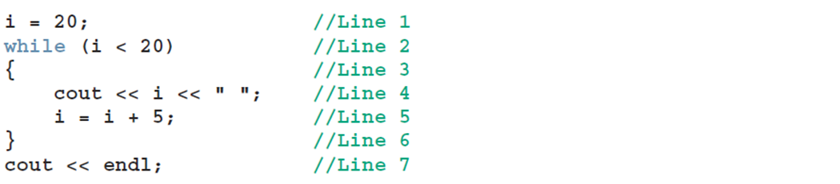
while Looping (Repetition) Structure (cont’d.)
EXAMPLE 5-2
Consider the following C++ program segment:

Slide 9
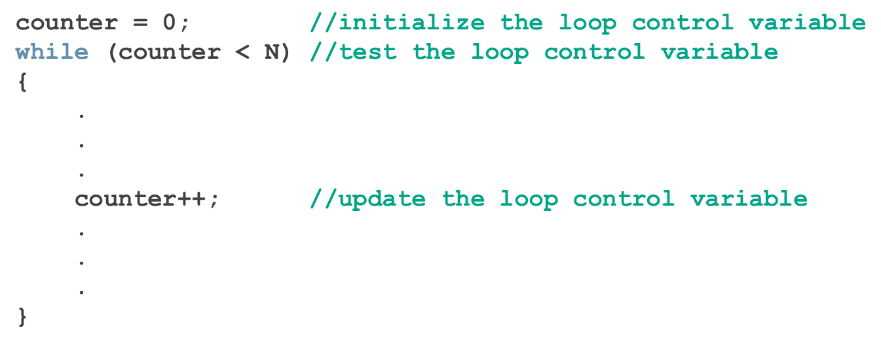
Case 1: Counter-Controlled while Loops
When you know exactly how many times the statements need to be executed
Use a counter-controlled while loop

Slide 10
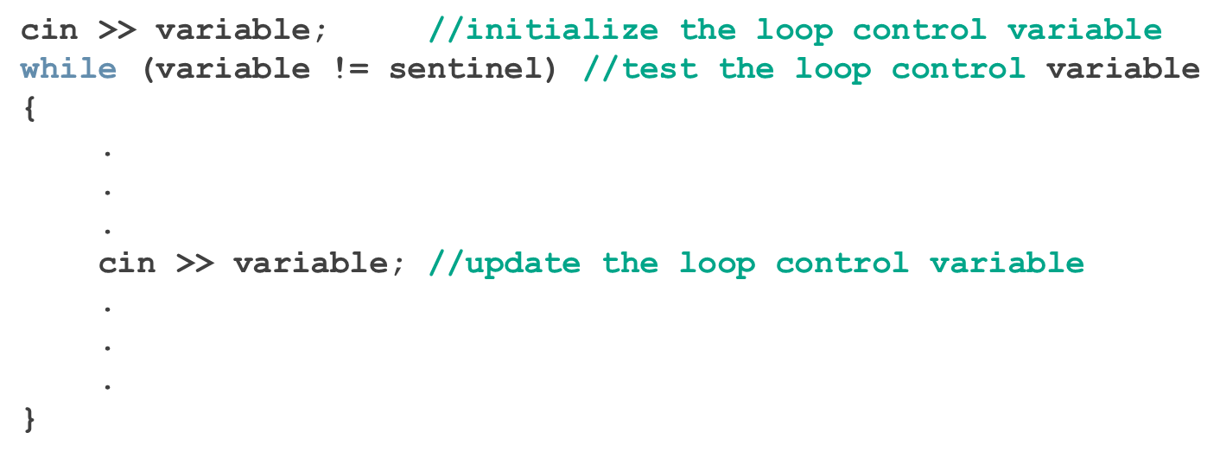
Case 2: Sentinel-Controlled while Loops
A sentinel variable is tested in the condition
The loop ends when the sentinel is encountered
The following is an example of a sentinel-controlled while loop:

Slide 11
Example 5-5: Telephone Digits
Example 5-5 provides an example of a sentinel-controlled loop
The program converts uppercase letters to their corresponding telephone digit
The sentinel value is #

Slide 12
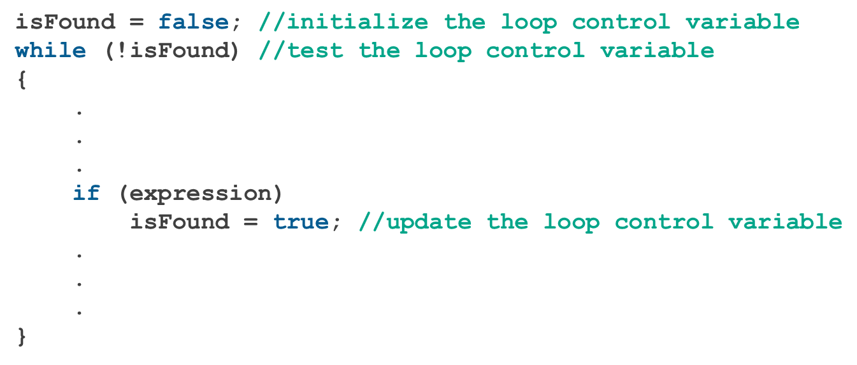
Case 3: Flag-Controlled while Loops
Flag-controlled while loop: uses a bool variable to control the loop

Slide 13


Number Guessing Game
Example 5-6 implements a number guessing game using a flag-controlled while loop
Uses the function rand of the header file cstdlib to generate a random number
rand() returns an int value between 0 and 32767
To convert to an integer

Slide 14
Case 4: EOF-Controlled while Loops (1 of 2)
An end-of-file (EOF)-controlled while loop is a good choice when it is difficult to select a sentinel value
The logical value returned by cin can determine if there is no more input

Slide 15
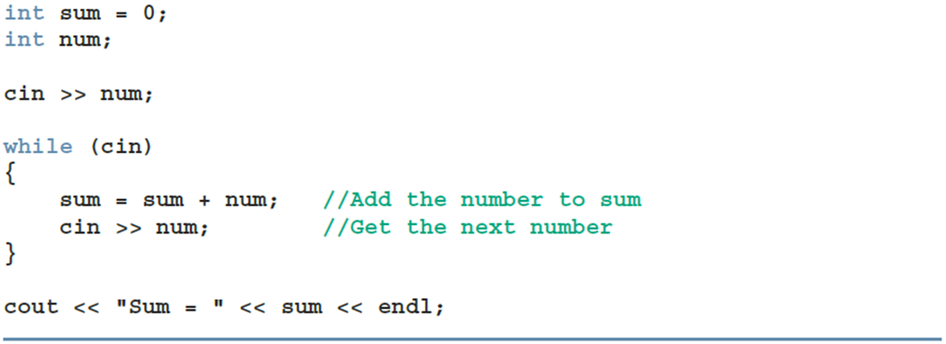
Case 4: EOF-Controlled while Loops (2 of 2)
EXAMPLE 5-7
The following code uses an EOF-controlled while loop to find the sum of a set of numbers:

Slide 16

eof Function
The function eof can determine the end of file status
eof is a member of data type istream
Syntax for the function eof
istreamVar is an input stream variable, such as cin

Slide 17
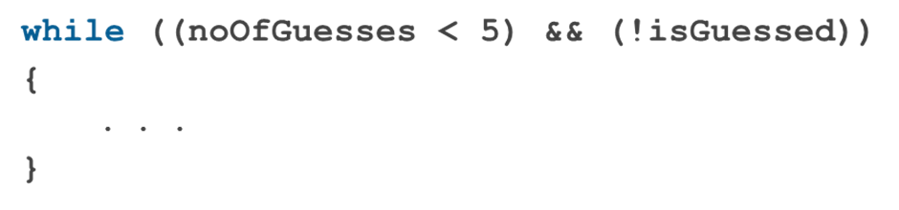
More on Expressions in while Statements
The expression in a while statement can be complex
Example

Slide 18
Programming Example: Fibonacci Number (1 of 3)
Consider the following sequence of numbers:
1, 1, 2, 3, 5, 8, 13, 21, 34, ....
Called the Fibonacci sequence
Given the first two numbers of the sequence (say, a₁ and a₂)
nth number a_{n}, n >= 3, of this sequence is given by: a_{n} = a_{n−1} + a_{n−2}

Slide 19
Programming Example: Fibonacci Number (2 of 3)
Fibonacci sequence
nth Fibonacci number
a₂ = 1
a₁ = 1
Determine the nth number a_{n}, n >= 3

Slide 20
Programming Example: Fibonacci Number (3 of 3)
Suppose a₂ = 6 and a₁ = 3
a₃ = a₂ + a₁ = 6 + 3 = 9
a₄ = a₃ + a₂ = 9 + 6 = 15
Write a program that determines the nth Fibonacci number, given the first two numbers

Slide 21
Programming Example: Input and Output
Input: first two Fibonacci numbers and the desired Fibonacci number
Output: nth Fibonacci number

Slide 22
Programming Example: Problem Analysis and Algorithm Design
Algorithm
Get the first two Fibonacci numbers
Get the desired Fibonacci number
Get the position, n, of the number in the sequence
Calculate the next Fibonacci number
Add the previous two elements of the sequence
Repeat Step 3 until the nth Fibonacci number is found
Output the nth Fibonacci number

Slide 23
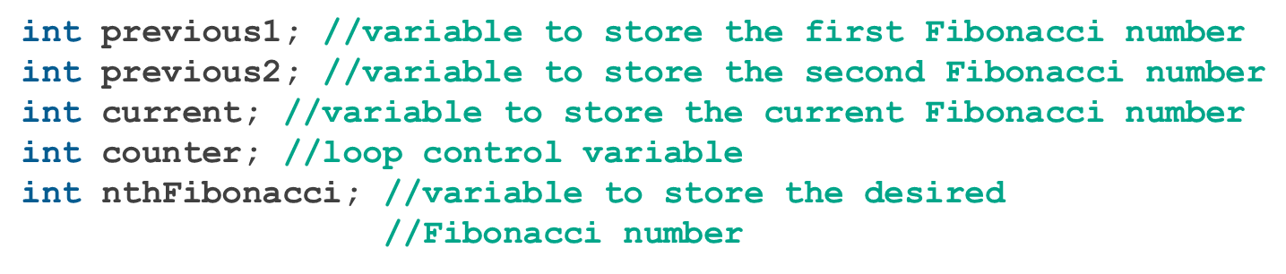
Programming Example: Variables

Slide 24
Programming Example: Main Algorithm (1 of 4)
Prompt the user for the first two numbers—that is, previous1 and previous2
Read (input) the first two numbers into previous1 and previous2
Output the first two Fibonacci numbers
Prompt the user for the position of the desired Fibonacci number

Slide 25
Programming Example: Main Algorithm (2 of 4)
Read the position of the desired Fibonacci number into nthFibonacci
if (nthFibonacci == 1) The desired Fibonacci number is the first Fibonacci number; copy the value of previous1 into current
else if (nthFibonacci == 2) The desired Fibonacci number is the second Fibonacci number; copy the value of previous2 into current

Slide 26
Programming Example: Main Algorithm (3 of 4)
else calculate the desired Fibonacci number as follows:
Start by determining the third Fibonacci number
Initialize counter to 3 to keep track of the calculated Fibonacci numbers.
Calculate the next Fibonacci number, as follows: current = previous2 + previous1;

Slide 27
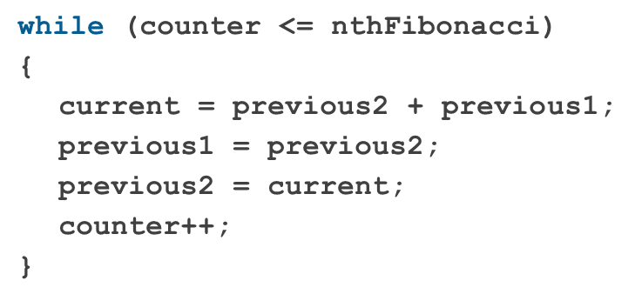
Programming Example: Main Algorithm (4 of 4)
Assign the value of previous2 to previous1
Assign the value of current to previous2
Increment counter
Repeat until Fibonacci number is calculated:
Output the nth Fibonacci number, which is current

Slide 28
for Looping (Repetition) Structure (1 of 7)
for loop: called a counted or indexed for loop
Syntax of the for statement
The initial statement, loop condition, and update statement are called for loop control statements

Slide 29
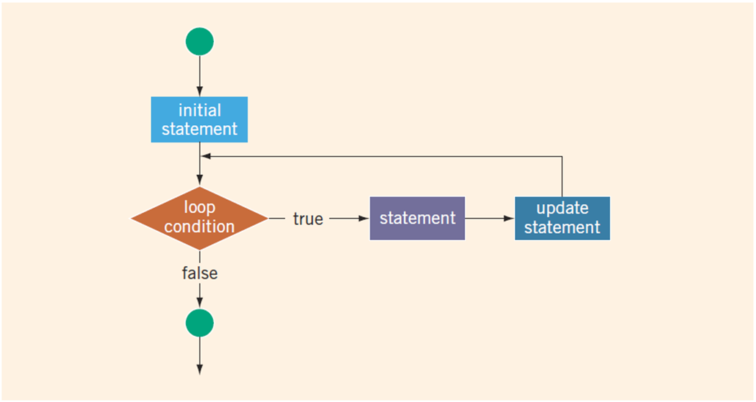
for Looping (Repetition) Structure (2 of 7)
FIGURE 5-2 for loop

Slide 30
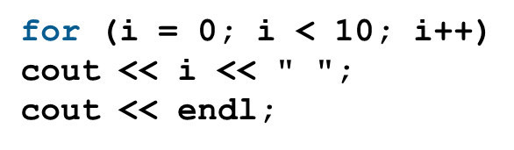
for Looping (Repetition) Structure (3 of 7)
EXAMPLE 5-9
The following for loop prints the first 10 nonnegative integers:
The initial statement, i = 0;, initializes the int variable i to 0. Next, the loop condition, i < 10, is evaluated. Because 0 < 10 is true, the print statement executes and outputs 0. The update statement, i++, then executes, which sets the value of i to 1. Once again, the loop condition is evaluated, which is still true, and so on. When i becomes 10, the loop condition evaluates to false, the for loop terminates, and the first statement following the for loop executes.

Slide 31
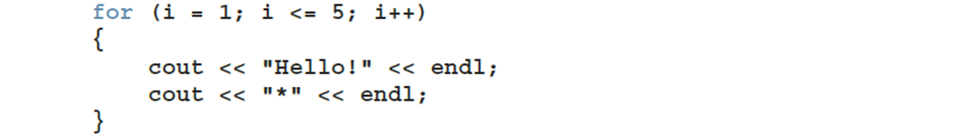
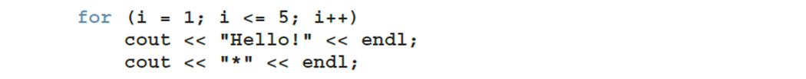
for Looping (Repetition) Structure (4 of 7)
EXAMPLE 5-10
The following for loop outputs Hello! and a star (on separate lines) five times:
Consider the following for loop:
The output of this for loop is:
Hello!
Hello!
Hello!
Hello!
Hello!
*

Slide 32
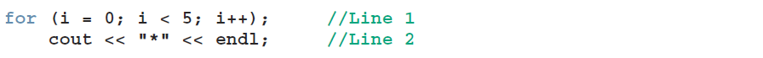
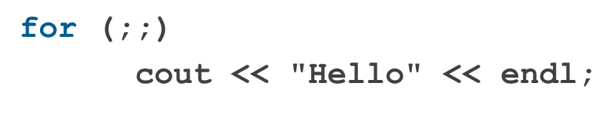
for Looping (Repetition) Structure (5 of 7)
The following is a semantic error:
EXAMPLE 5-11
The following for loop executes five empty statements:
The semicolon at the end of the for statement (before the output statement, Line 1)terminates the for loop. The action of this for loop is empty, that is, null. As in Example 5-10(2), the indentation of Line 2 is
The following is a legal (but infinite) for loop:

Slide 33
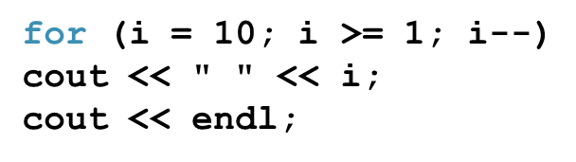
for Looping (Repetition) Structure (6 of 7)
EXAMPLE 5-12
You can count backward using a for loop if the for loop control expressions are set correctly.
For example, consider the following for loop:
The output is:
10 9 8 7 6 5 4 3 2 1
In this for loop, the variable i is initialized to 10. After each iteration of the loop, i is decremented by 1. The loop continues to execute as long as i >= 1.

Slide 34

for Looping (Repetition) Structure (7 of 7)
EXAMPLE 5-13
You can increment (or decrement) the loop control variable by any fixed number. In the following for loop, the variable is initialized to 1; at the end of the for loop, i is incremented by 2. This for loop outputs the first 10 positive odd integers.
The output is:
1 3 5 7 9 11 13 15 17 19

Slide 35
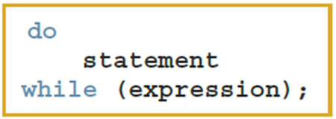
do…while Looping (Repetition) Structure (1 of 6)
Syntax of a do...while loop
The statement executes first, and then the expression is evaluated
As long as expression is true, loop continues
To avoid an infinite loop, body must contain a statement that makes the expression false

Slide 36
do…while Looping (Repetition) Structure (2 of 6)
The statement can be simple or compound
Loop always iterates at least once

Slide 37
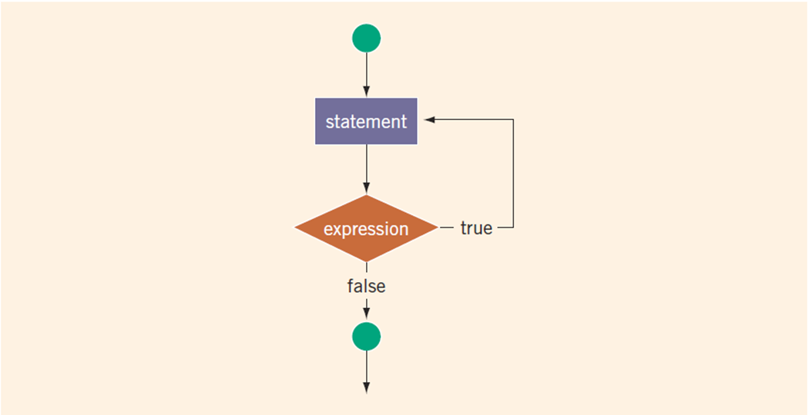
do…while Looping (Repetition) Structure (3 of 6)
FIGURE 5-3 do. . .while loop

Slide 38
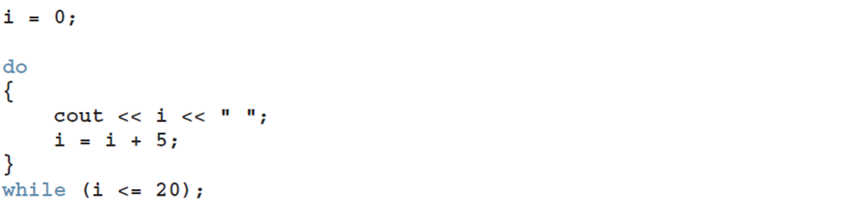
do…while Looping (Repetition) Structure (4 of 6)
EXAMPLE 5-18
The output of this code is:
0 5 10 15 20
After 20 is output, the statement:
i = i + 5;
changes the value of i to 25 and so i <= 20 becomes false, which halts the loop.

Slide 39
do…while Looping (Repetition) Structure (5 of 6)
Note that while and for loops are pretest loops
It is possible that these loops many never activate due to entry conditions
In contrast, do. . .while loops are posttest loops
These loops always execute at least once

Slide 40
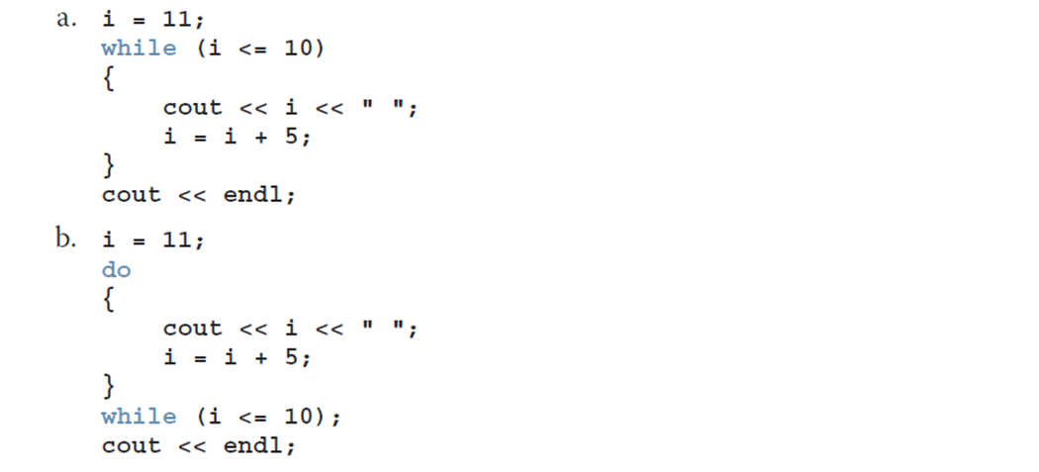
do…while Looping (Repetition) Structure (6 of 6)
EXAMPLE 5-19
Consider the following two loops:
In (a), the while loop produces nothing, the statement never executes. In (b), the do. . .while loop outputs the number 11 and also changes the value of i to 16. This is expected because in a do. . .while, the statement must always execute at least once.

Slide 41
Choosing the Right Looping Structure
All three loops have their place in C++
If you can determine in advance the number of repetitions needed, the for loop is the correct choice
If you do not know and cannot determine in advance the number of repetitions needed, and it could be zero, use a while loop
If you do not know and cannot determine in advance the number of repetitions needed, and it is at least one, use a do...while loop

Slide 42
break and continue Statements (1 of 2)
break and continue alter the flow of control
break statement is used for two purposes:
To exit early from a loop
To skip the remainder of a switch structure
After break executes, the program continues with the first statement after the structure
A break statement in a loop can eliminate the use of certain (flag) variables

Slide 43
break and continue Statements (2 of 2)
continue is used in while, for, and do…while structures
When executed in a loop
It skips remaining statements and proceeds with the next iteration of the loop

Slide 44
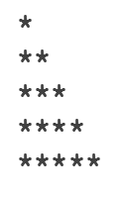
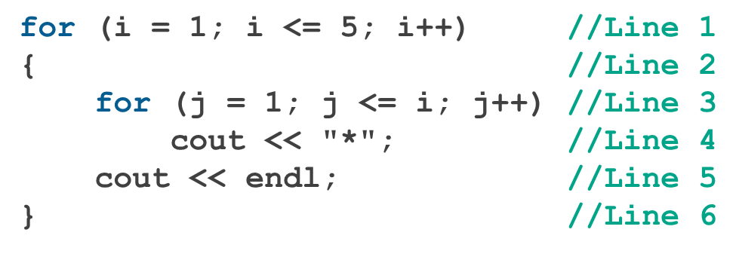
Nested Control Structures (1 of 2)
To create the following pattern:
We can use the following code:

Slide 45

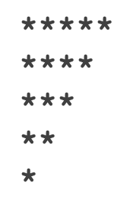
Nested Control Structures (2 of 2)
What is the result if we replace the first for statement with this?
Answer:

Slide 46
Avoiding Bugs by Avoiding Patches
A software patch is a piece of code written on top of an existing piece of code
Intended to fix a bug in the original code
Some programmers address the symptom of the problem by adding a software patch
A programmer should instead resolve the underlying issue

Slide 47
Debugging Loops
Loops are harder to debug than sequence and selection structures
Use a loop invariant
Set of statements that remains true each time the loop body is executed
The most common error associated with loops is off-by-one

Slide 48
Quick Review (1 of 3)
C++ has three looping (repetition) structures:
while, for, and do…while
while, for, and do are reserved words
while and for loops are called pretest loops
do...while loop is called a posttest loop
while and for may not execute at all, but do...while always executes at least once

Slide 49
Quick Review (2 of 3)
In a while loop:
The expression is the decision maker
The statement is the body of the loop
A while loop can be:
Counter-controlled
Sentinel-controlled
EOF-controlled
In the Windows console environment, the end-of-file marker is entered using Ctrl+z

Slide 50
Quick Review (3 of 3)
A for loop simplifies the writing of a counter-controlled while loop
Putting a semicolon at the end of the for loop is a semantic error
Executing a break statement in the body of a loop immediately terminates the loop
Executing a continue statement in the body of a loop skips to the next iteration

